Slide 1
A Billion
Reasons to Care

Slide 2
Context
28,000 publicly funded long-term care beds
1,500 private beds in publicly funded care homes
Approximately 3,000 private beds in private care homes without public funding
Current Distribution of Beds
Health Authority
For-Profit
Not-For-Profit

Slide 3
What did we review?
1.
2.
3.
CONTRACTS
AUDITED FINANCIAL STATEMENTS
UNAUDITED EXPENSE REPORTS
2017/18
2016/17 2017/18
2016/17
2017/18
Contracted long-term care homes

Slide 4
Expense reporting deficiencies
Reporting is inconsistent between health authorities
Calculations for direct care hours is inconsistent between health authorities and does not always count 100% occupancy or all care beds
Capital costs calculations for buildings vary between health authority and no attempts to verify fair market value
Large expenditures for broad categories such as management fees, head office allocation, administrative expenses with no detail

Slide 5
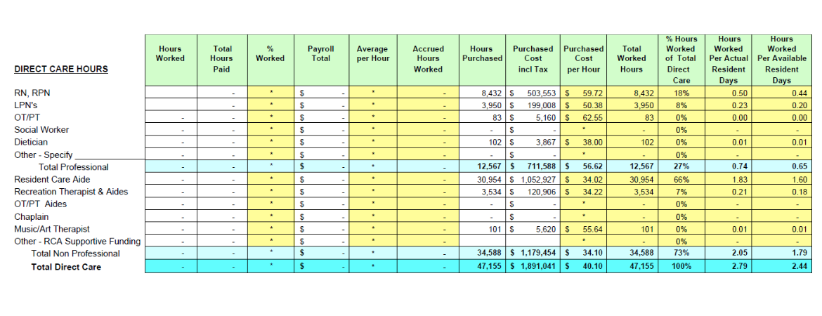
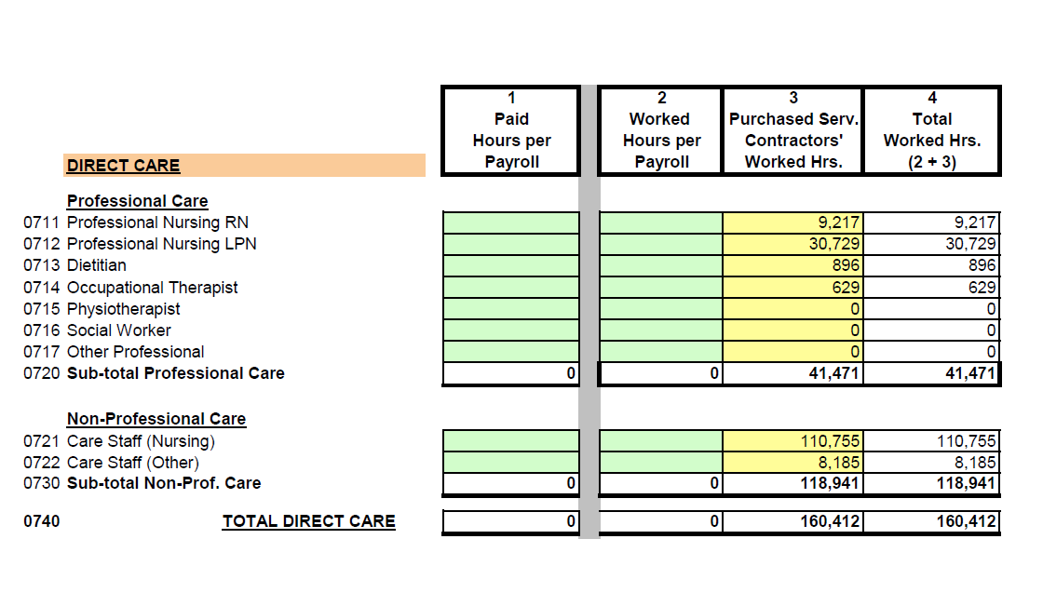
Service data

Slide 6
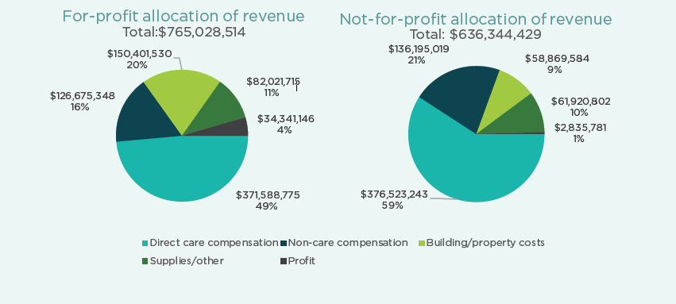
What did we find?
$1.4 billion in total revenue as a sector
$1.3 billion from public funding
Spending
72% on staffing | 10% on supplies
54% on direct care | 4% on profit
15% on building cost

Slide 7
What are the differences?
Not-for-profit and for-profit receive the same amount of per diem funding
Not-for-profit sector spends 59% of their revenue on direct care, vs 49% by the for-profit sector
For-profit sector failed to deliver 207,000 hours of funded care
Not-for-profit sector over delivered 80,000 more care hours than they were funded to deliver
For-profit operators generate 12x the surplus that not-for-profit operators produce, $34.4 million compared to $2.8 million
For-profit operators expensed more than twice as much as not-for-profits on capital building costs, 20% vs 9%
Cost per worked hour in the for-profit sector was lower for all direct care jobs, some care aides were paid as much as 28%, or $6.63 an hour less than the industry standard

Slide 8
Difference in direct care expenditures
For-Profit
Not-For Profit

Slide 9
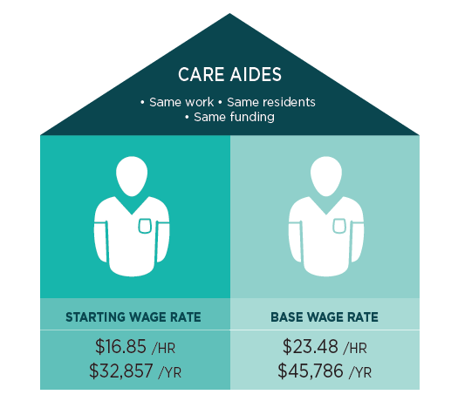
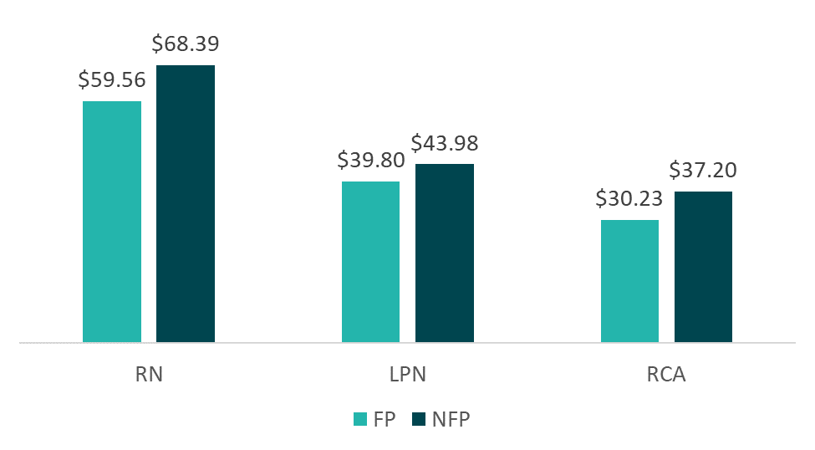
Staffing costs drive direct care costs
Average cost of one worked hour of care
For-Profit
Not-For Profit

Slide 10
Building costs
There are significant building cost differences between the for-profit and the not-for-profit sector. As the chart below illustrates, the for-profit sector is funded for much higher rates of building capital relative to the not-for-profit sector, while also generating higher rates of profit.
Total Capital Building Costs For-Profit = $95,237,350
Total Profit/Surplus For-Profit = $34.4 million
Total Capital Building Costs Not-For-Profit = $30,700,507
Total Profit/Surplus For-Profit = $2.8 million
 | For-Profit | Not-For-Profit
Mortgage interest | $5,270 | $2,034
Mortgage principal | $3,149 | $1,333
Depreciation | $4,477 | $1,748
Replacement reserves | $296 | $237
Profit/surplus | $3,399 | $348

Slide 11
Profit and loss
The profit produced by the 66% of care homes that report profit is $59 million. However, the amount of surplus/profit reported varies greatly between care homes in the for-profit sector and care homes in the not-for-profit sector.
 | For-Profit | Not-For-Profit
# facilities showing profit | 69 | 45
Total profit | $49,528,790 | $9,024,337
Beds–total | 6,985 | 4,438
Minimum profit | $7,446 | $4,494
Maximum profit | $2,750,976 | $1,431,332
Average profit | $717,809 | $200,541
Average profit per bed | $7,248 | $2,590

Slide 12
Example
For-Profit Care Home
Not-For-Profit Care Home
Total revenue | $17,768,604
Total expenses | $15,807.574
Profit | $1,961,030
Total revenue | $18,186,645
Total expense | $18,675,419
Surplus/deficit | ($486,774)
In addition to paying for direct care staffing, food, housekeeping, plant services, and laundry; the care home was paid an additional $4.5 million for the following:
In addition to paying for direct care staffing, food, housekeeping, plant services, and laundry; this care home reported $2.1 million for the following expenses:
Mortgage principal and interest | $2,601,017
Maintenance and repairs | $542,067
Administrative expenses | $202,389
Audit/insurance/association dues | $114,373
Managers (support/food services, finance) | $202,479
Administrative support (book keeper, reception) | $407,354
Management fee | $446,040
Mortgage interest and principal | $99,999
CMHC Replacement Reserves | $73,826
Maintenance and repairs | $231,896
Administrative expenses | $370,148
Audit/insurance/association dues | $80,217
Managers (support/food services, finance) | $447,867
Administrative support (book keeper, reception) | $796,332

Slide 13
Recommendations
Remove the financial incentive for operators to do anything other than provide as many care hours as possible with the public money they receive to deliver direct care
1
Funding Direct Care
2
Care Hour Monitoring
Tighter standardized reporting for direct care hours
Consider the role licensing can play with regulatory changes to staffing language
3
Define Profit
Decide how building capital is treated
Determine what expenses will be allowed
Apply decision to all care homes
Standardized Reporting
Collect the same information in the same format across all health authorities
Report at the provincial level
4
Public Reporting
Require publicly reported revenues and expenditures for publicly funded care homes
5

Slide 14
A Billion
Reasons to Care

