Slide 1
BILLIONS MORE REASONS TO CARE
Contracted Long-Term Care-Funding Review Update
September 25, 2023
Isobel Mackenzie BC Seniors Advocate

Slide 2
Changing Landscape of Long-Term Care
Over the last 5 years:
COVID-19 pandemic
Funding increases to boost staffing levels
Funding to increase infection control
Wage levelling
Development of a standardized provincial reporting template
Health Care Career Access Program

Slide 3
Long-Term Care Funding
In 2021/22:
$2.9 billion health authority spending on long-term care (45% ↑ over five yrs.)
$1.9 billion (65%) of all spending for long-term care was on contracted (for-profit and non-profit) operators (35% ↑ over five yrs.)

Slide 4
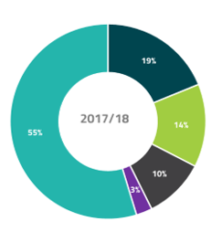
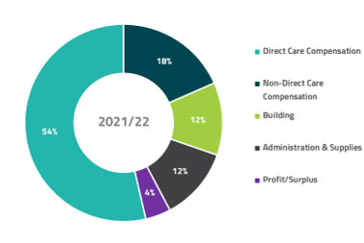
Allocation of Funding
Over the past 5 years:
33% ↑ in direct care costs
33% ↑ in non-direct care staff compensation
18% ↑ in capital building costs
61% ↑ in the cost of supplies/administration/other
113% ↑ in profit
Expenditures – Contracted Long-Term Care

Slide 5
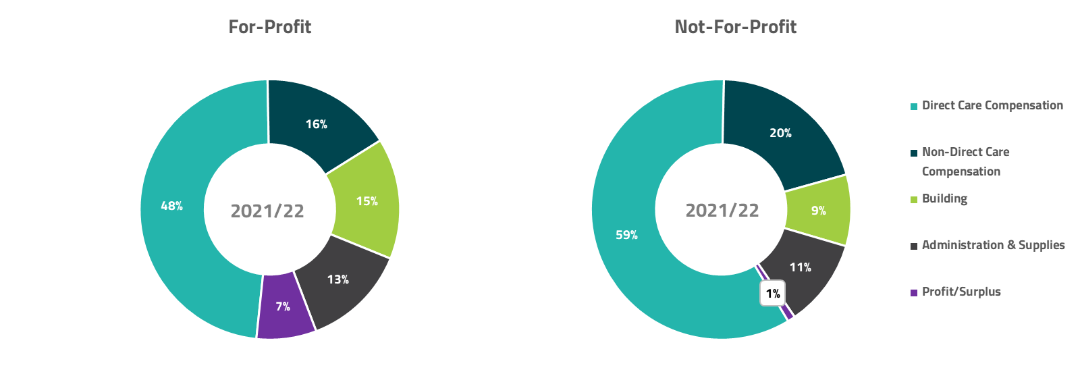
Differences: For-Profit and Not-For-Profit

Slide 6
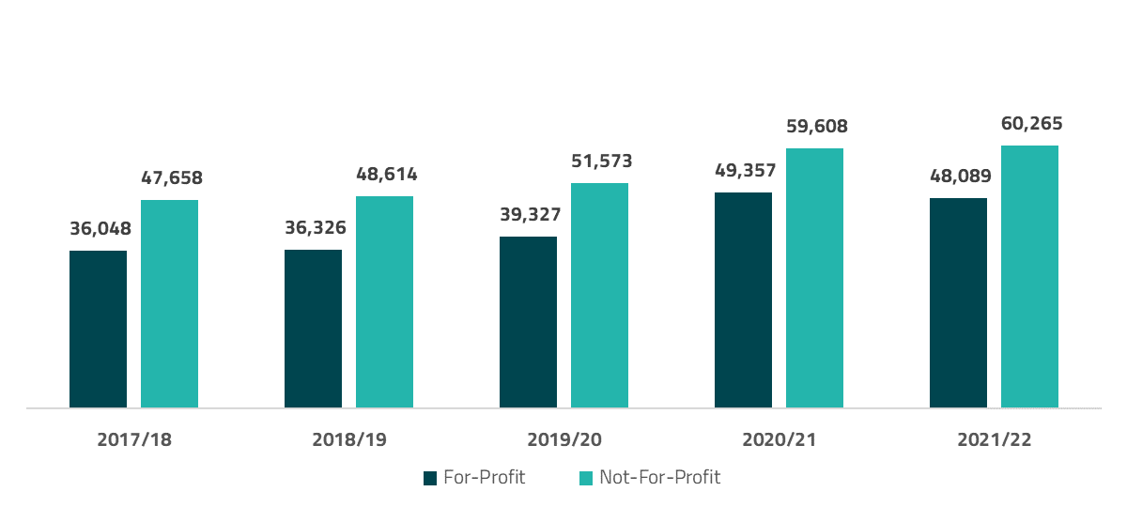
Direct Care Staffing Expenditures Per Bed

Slide 7
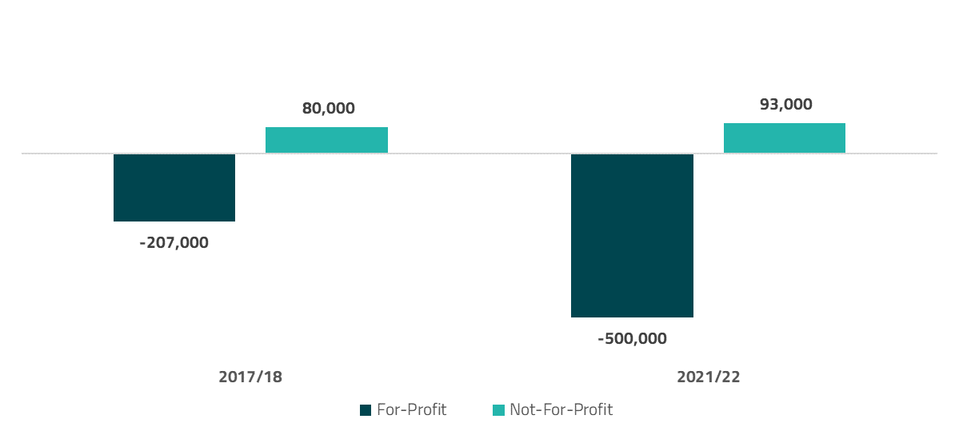
Funded vs. Delivered Care Hours

Slide 8
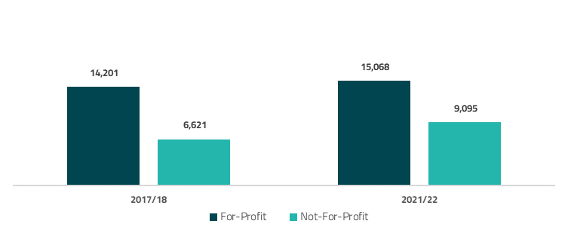
Building Expenses

Slide 9
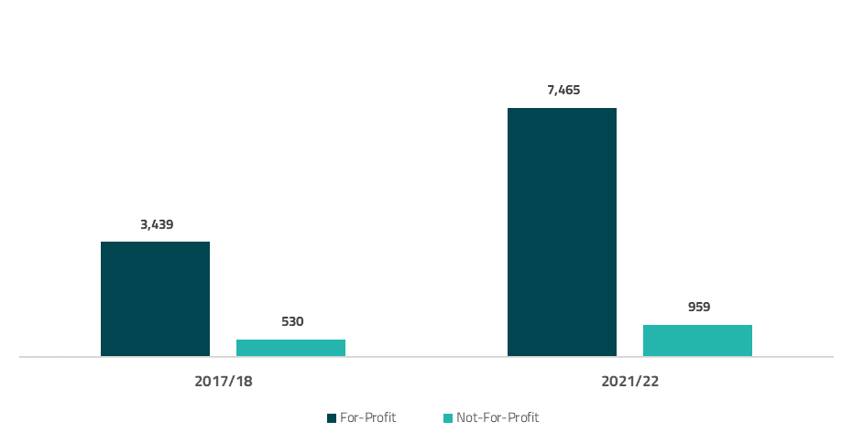
Profit
74% of facilities made a profit (68% ↑ over five yrs.)
80% of profit concentrated in 20% of facilities

Slide 10
For-Profit vs. Not-For-Profit Facilities
Comparison of Not-For-Profit and For-Profit Mid-Size Facilities (Average 151 Beds)
Not-For-Profit Care Home
For-Profit Care Home
TOTAL REVENUE | $14,979,548
TOTAL STAFFING COSTS | $12,849,600
TOTAL BUILDING EXPENSES | $1,397,357
Mortgage (principal and interest) | $295,634
Taxes/Utilities/Waste | $294,336
Maintenance/Repairs | $492,672
Replacement Reserves | $296,715
CMHC Replacement Reserve | $18,000
TOTAL ADMIN. EXPENSES | $329,298
Admin./office expenses | $253,574
Audit/insurance/assoc. dues | $75,724
Mgmt. fee | -
TOTAL SUPPLIES | $975,392
TOTAL EXPENSES | $15,551,647
SURPLUS/LOSS | -$572,099
TOTAL REVENUE | $15,961,192
TOTAL STAFFING COSTS | $8,178,568
TOTAL BUILDING EXPENSES | $2,837,606
Mortgage (principal and interest) | $2,329,309
Taxes/Utilities/Waste | $305,398
Maintenance/Repairs | $183,751
Replacement Reserves | $19,148
CMHC Replacement Reserve | -
TOTAL ADMIN. Expenses | $661,992
Admin./office expenses | $217,259
Audit/insurance/assoc. dues | $102,329
Mgmt. fee | $342,404
TOTAL SUPPLIES | $932,916
TOTAL EXPENSES | $12,611,082
SURPLUS/LOSS | $3,350,110

Slide 11
Conclusions
No change over 5 years
Funding system is not focused on maximizing resident care
System is inequitable to operators
Issue will grow without fundamental reform on funding contracted long-term care

Slide 12
Recommendations
Funding for Care Must be Spent on Care: Financial incentives needed to ensure operators spend the money received to provide direct care on direct care.
Make Revenues and Expenditures for Publicly Funded Care Homes Available to the Public: Public is entitled to know how their money is spent and access financial information about each facility.
Improve Accuracy and Transparency of Reporting for Compliance with Funded Care Hours: Current self-reporting of care hours is vulnerable to exploitation.
Define Profit: No standardized approach to determining what is counted as profit. Greater understanding of the details of expenses required.

Slide 13
Contact
Toll-free: 1-877-952-3181
In Victoria: 250-952-3181
Monday to Friday: 8:30am–4:30pm
www.seniorsadvocatebc.ca
info@seniorsadvocatebc.ca
facebook.com/SeniorsAdvocateBC
@SrsAdvocateBC

